Slide 1
Leveraging Common Tools in Online Courses
Jenny Deranek, PhD, LAT, ATC
Program Director & Clinical Assistant Professor
Vera Z. Dwyer College of Health Sciences
Indiana University South Bend

Slide 2
Learning Outcomes
Attendees will be able to state the definition and benefit of service learning experiences.
Attendees will be able to identify valuable technological tools to enhance their courses (VoiceThread, Canvas pages, electronic submissions, Zoom, etc. )
Attendees will be able to determine what technology may best fit their ongoing or new service learning courses.

Slide 3
Vera Z. Dwyer College of Health Sciences Division of Health Sciences Bachelor of Science in Health Sciences
Health Promotion
Health Systems Leadership
Sports and Exercise Science
Speech Language Pathology
Rehabilitation Science
76
6
30
20
81
Minors: Billing and Coding, Health Promotion, Nutrition, Sports and Exercise Science
Notes:
HSC began in 2015, first graduating class in 2016
213 students total

Slide 4
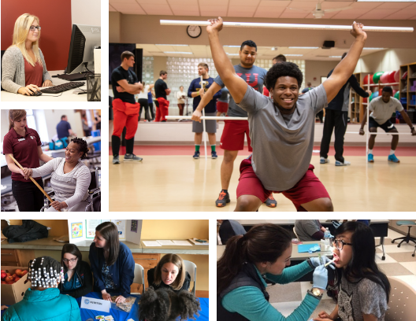

Slide 5
HSC-A291/491: Service Learning in Health Sciences
3 credit hours (120 hours)
A291 vs. A491
137 students completed
B.S. in Health Sciences began in 2015 at IU South Bend
Notes:
137 Students total completed the course

Slide 6
Why Service Learning and not Internship?
Indiana University South Bend community has provided more then $9.3 million of charitable donations and volunteer services (IUSB, 2017)
Desire meaningful work and dedication to making a difference through volunteer service

Slide 7
Service Learning
Students develop critical thinking skills, interpersonal skills, and leadership skills through hands-on, real-world application. Students connect theory and academic course content which improves the connection and application of content (Tarantino, 2017).
Positively impact their future employment
Provide positive contribution to the community
Create responsive healthcare professionals

Slide 8
Course Learning Objectives

Slide 9
Mode of Delivery
Notes:
Variable credit course
Use of a variety of technological modalities: Google documents, discussion board, VoiceThread, Zoom video, Qualtrics survey

Slide 10
Website

Slide 11
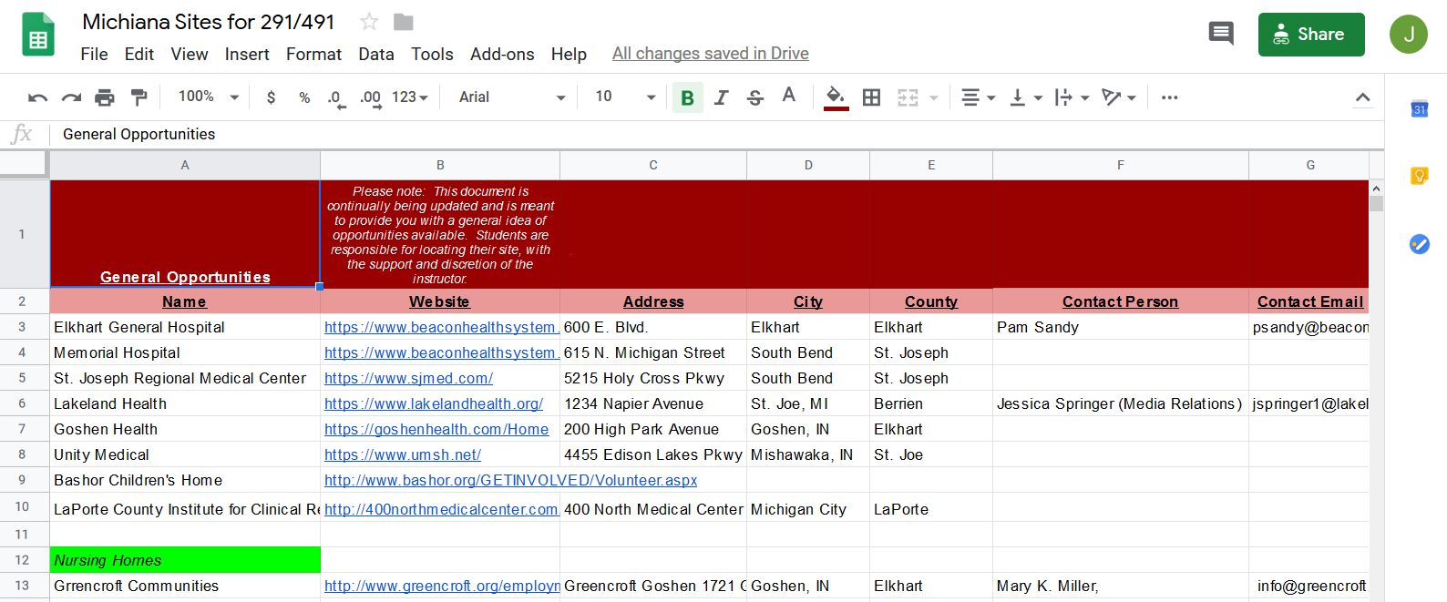
Community Sites
Notes:
How to get sites
Personal connections
Students reaching out
Hunger in the area

Slide 12
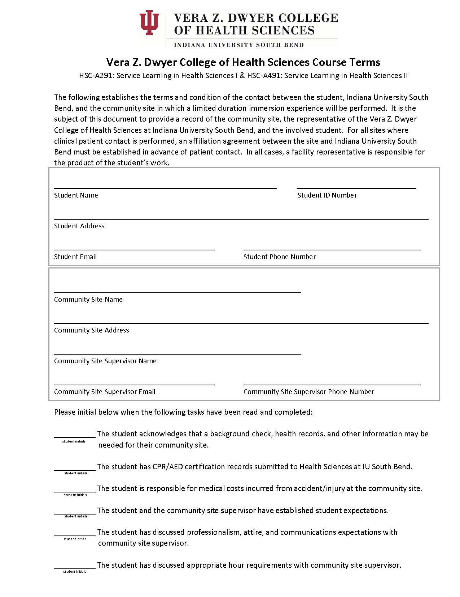
Notes:
Electronic submission – or drop off at my office if available.
Approved by IU legal – we have a lot of clinical programs

Slide 13
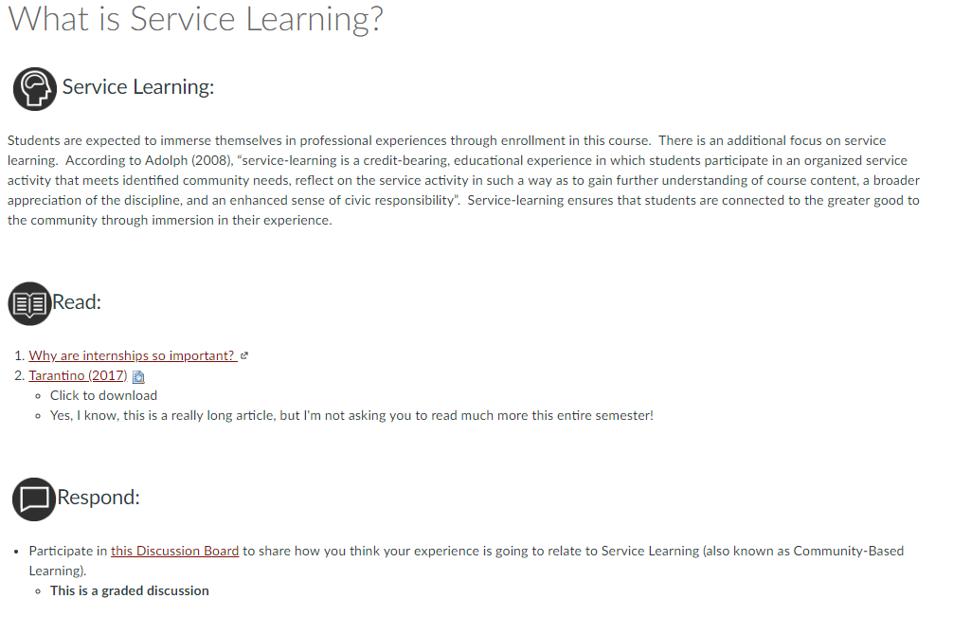
Discussion Board

Slide 14
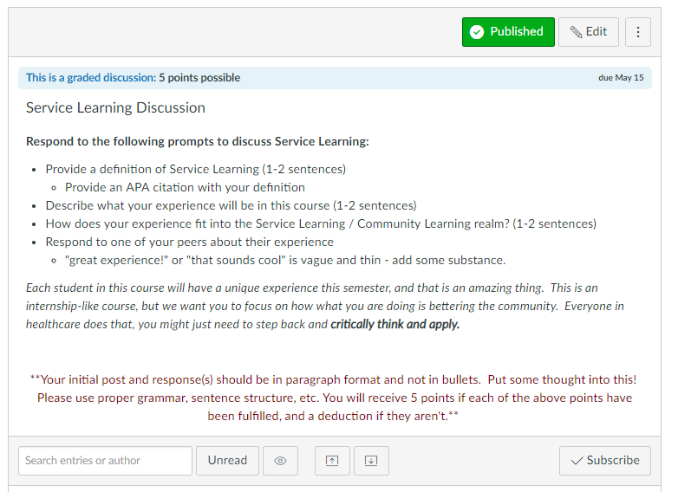
Discussion Board

Slide 15
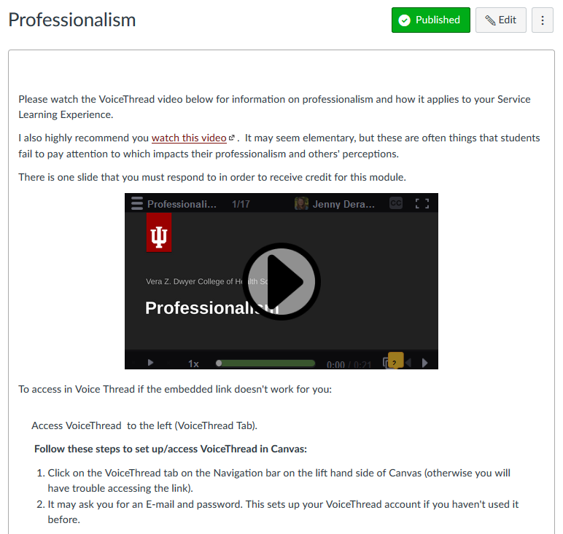
VoiceThread

Slide 16
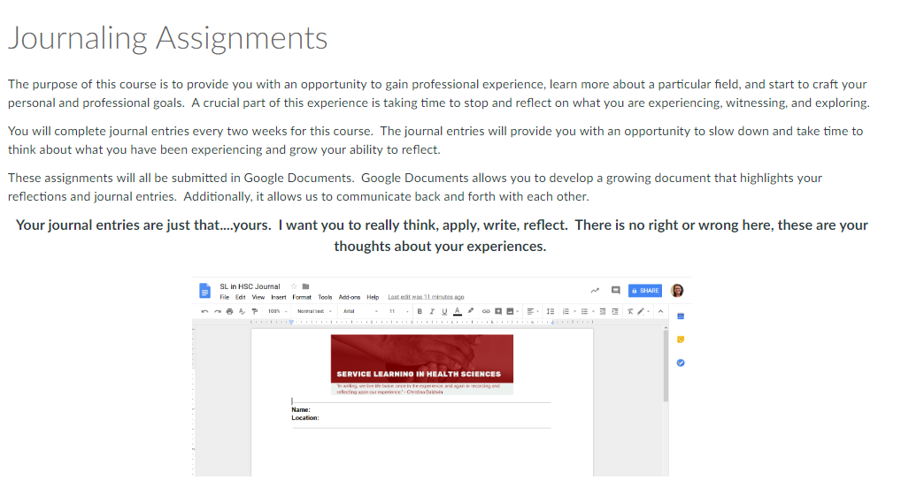
Google Documents
Notes:
https://docs.google.com/document/d/1BaWtZ4rYfXRyPNm3jVIq2wvuIQ9keCRMsqzrOxFStUo/edit?usp=sharing

Slide 17
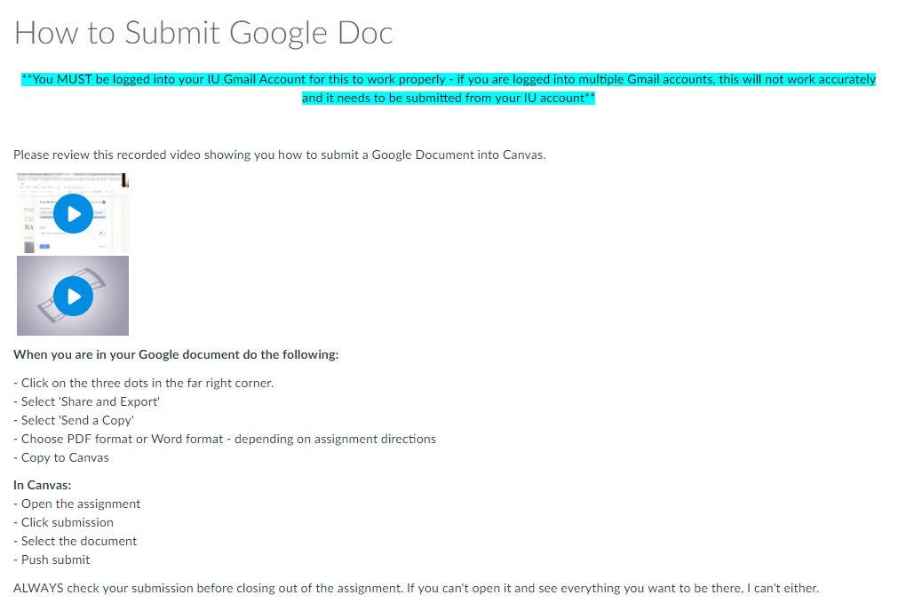
Google Documents

Slide 18
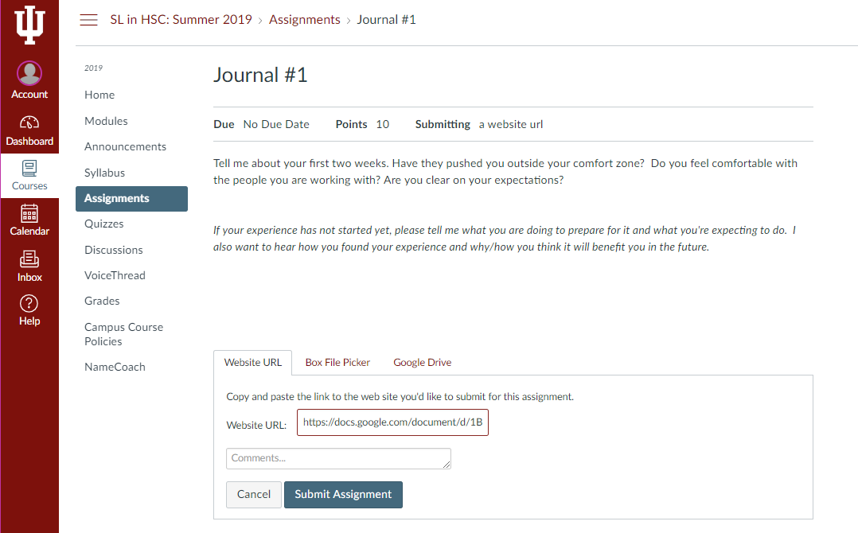
Google Documents

Slide 19
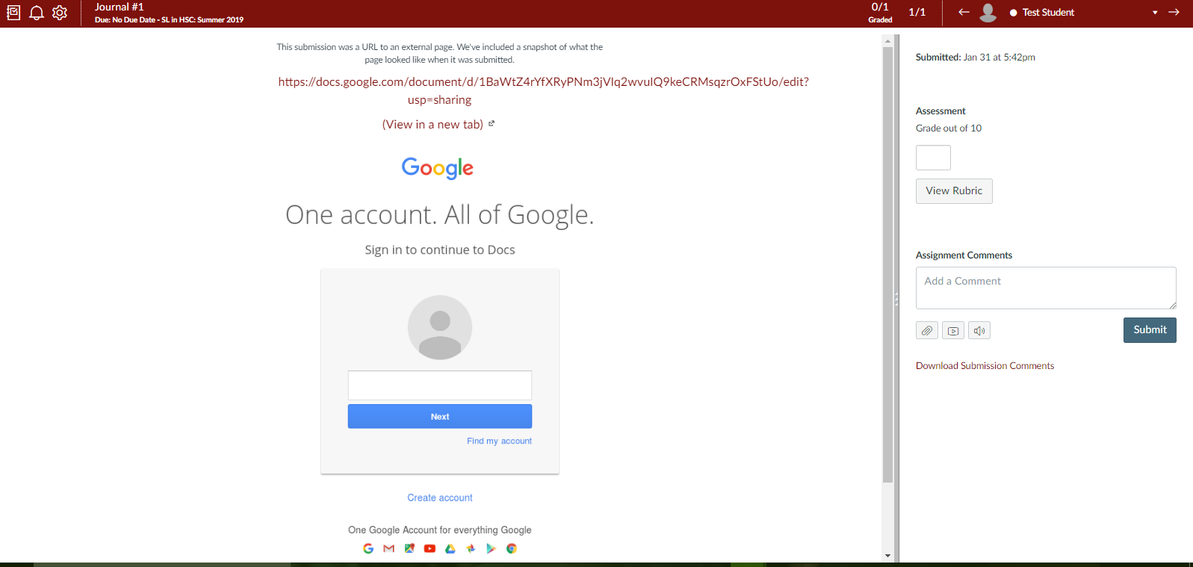
Google Documents

Slide 20
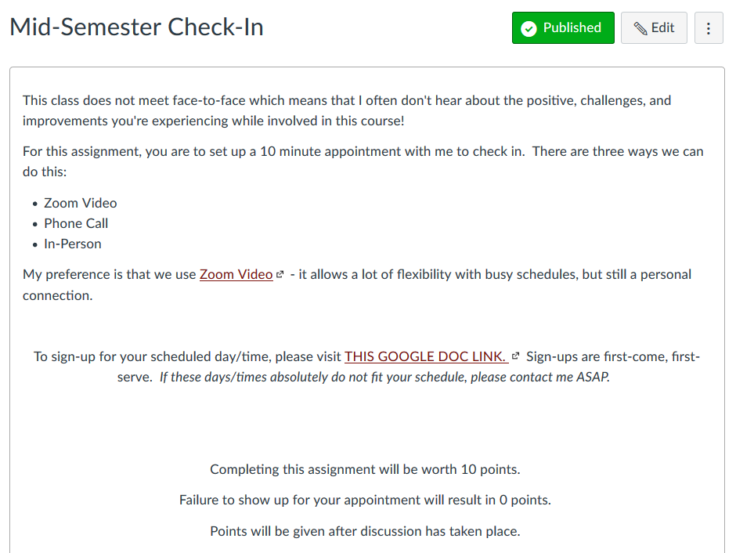
Zoom Video Conferencing

Slide 21
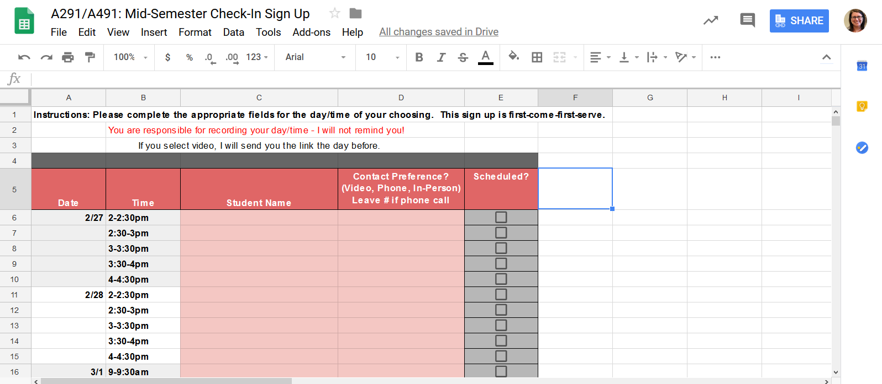
Google Sheets

Slide 22
Qualtrics survey
Notes:
Qualtrics survey allows me to analyze and use in program evaluation

Slide 23
Review
Service Learning in Health Sciences
Website Development
Electronic Submissions
Discussion Boards
VoiceThread
Google Documents
Zoom Video Conferences
Google Sheets
Qualtrics

Slide 24
